Slide 1
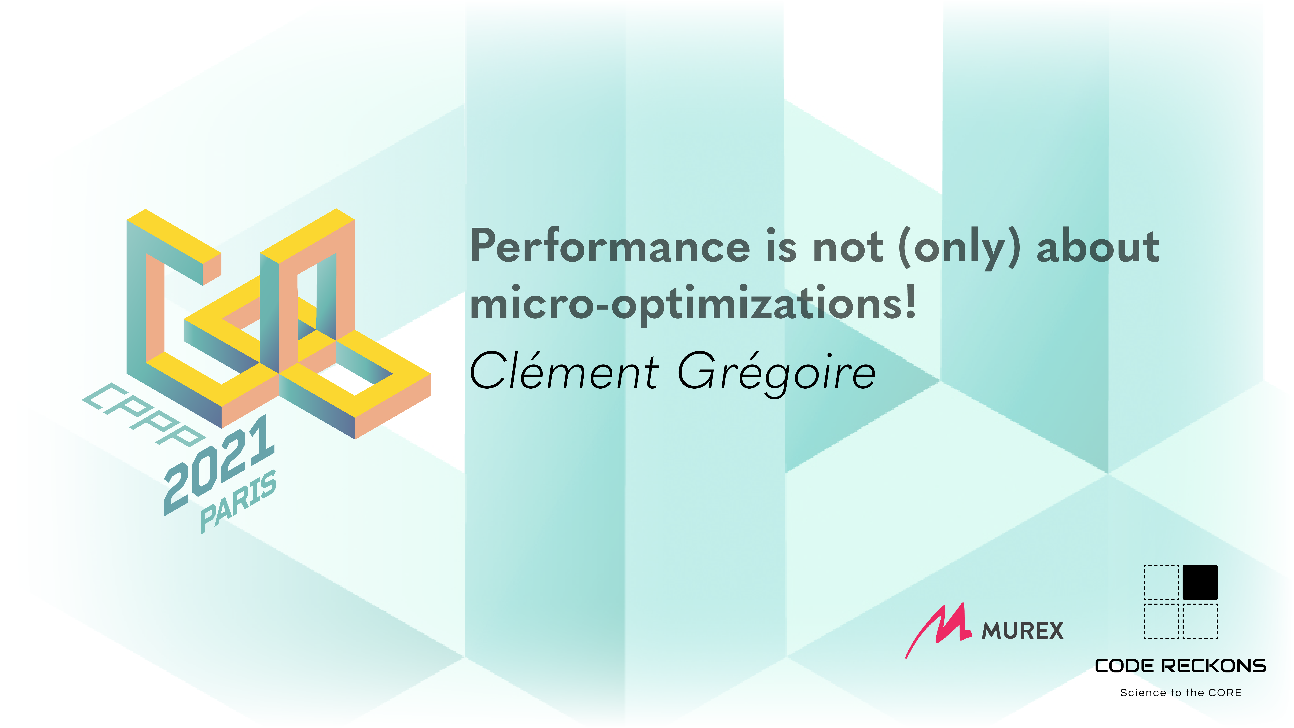

Slide 2

Performance is not (only) about micro-optimizations!

Slide 3



Who am I?
Clément GREGOIRE
10 years of C++ Programming
5 years in game-dev
Microsoft Flight Simulator
Various ports
Software optimization is my job
Co-founder & consultant

Slide 4
This talk is
Not meant to convince you performance is important
Not your usual micro-benchmarking talk (obviously)
Not specific to C++
"Performance Matters" by Emery Berger
https://youtu.be/r-TLSBdHe1A

Slide 5

Software performance
What’s that?

Slide 6


Speed
How long does it take for a task to execute? Latency?
CPU
GPU
Network
Startup / loading time
Notes:
Ex: Compile time, gta loading times
https://nee.lv/2021/02/28/How-I-cut-GTA-Online-loading-times-by-70/

Slide 7
Memory usage
How much memory can we afford to use?
Do we need to play nice with other applications?
Embedded
Cloud
Video games
PC vs Console
Multi-tasking
Notes:
Embedded: Usually limited RAM
Cloud: pay for what you use
Video games
Defines the low specs
consoles
XOne: 5GB
Xone X: 9GB
XSS: 7.5GB
XSX: 13GB
Multi-tasking
- Will your web browser play nice?

Slide 8


Storage
What is my package size?
How long will it take to download?
Embedded
Docker images
Games
Textures, sounds, 3D models, …
Web
Images, minification, …
“Fallout 76’s Day One Patch is Larger Than the Actual Game”

Slide 9
Resilience
Security (DoS)
Scaling up
Availability
Notes:
Nowadays we are used to seeing connexion queues at launch or under high traffic.
Performance problems were also the cause of outages of major companies services multiple times in the past years

Slide 10
Maintainability
Speed
Development / prototyping
Identification of performance issues
Iteration/build time (Live++ anyone?)
Debug mode performance

Slide 11

Optimizations
Where to begin?
Notes:
We’ll see
1 - theory
2 ⁻ use case

Slide 12
The optimization cycle
Macro-optimizations
Measure
Micro-optimizations
Define the target
Refine target
Good enough?

Slide 13
Defining performance objectives
A few examples
60 frames per second
8GB of memory maximum
Web page loading < 1s
Be the best (=> no target, only if you have time to afford it)

Slide 14
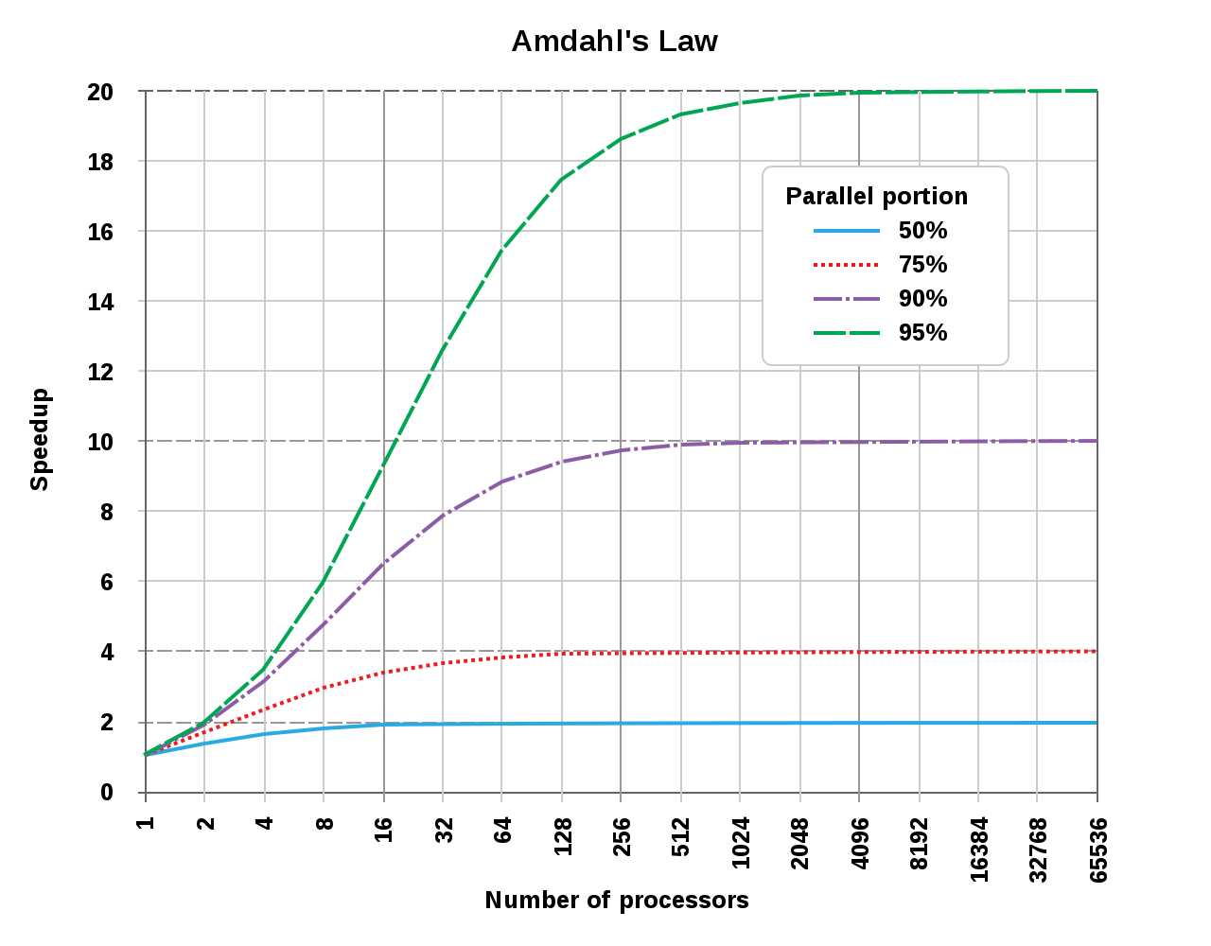
Defining performance objectives
Feasibility and cost-effectiveness
Can this actually be done?
How long will it take?
Is it an isolated use-case?
Buy better hardware? (yes but no, end of Moore’s law, Amdahl’s law, …)
Notes:
Flight simulator and its TB of data was not possible 10years ago (if only due to the bandwidth at home)
If you need 1 week to optimize a 5 minutes compute used once a year, is it worth it?
https://en.wikipedia.org/wiki/Amdahl%27s_law (augmenter le nombre de cores a une limite)

Slide 15

Measure
The most important part!

Slide 16
Performance testing
Reproducible
As deterministic as possible
Choice of input data is important
Size must be realistic
Represents the system in production or at its limits
Notes:
Study various cases and conditions, you may sacrifice performance in on case to benefit the other. Decide what matters!

Slide 17
With a single measurement
Gain
Before
After
-0.2ms (-1.2%)
16.8ms
16.6ms

Slide 18

Ship it?

Slide 19
Environment stability
(Do not leave YouTube running in the background)
Sometimes from single to double
Close unnecessary programs
Lock the CPU / GPU frequency
Be wary of temperature and power supply
So much more
Link order, environment variables, ASLR, code/allocations alignment…
https://doc.calcite.siliceum.com/performance/stability

Slide 20
The solution
Repeat the experiment!

Slide 21
Use units correctly
% only if no other way to describe it correctly
Cache miss rate ✅
Branch misprediction✅
Timings❌
Memory❌
No unit expressed in « ops / X » (FPS, throughput)
Ok for a marketing effect
Bad when looking at improvements
Same modifications in different order => different results
NO AVERAGE → Use median / percentiles / statistical tests…

Slide 22
Profilers
Tools of the trade

Slide 23
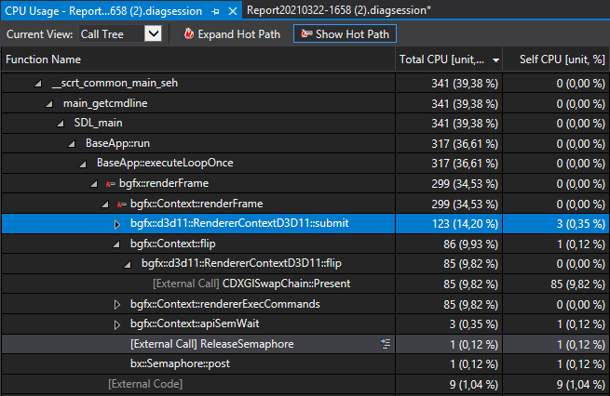
Sampling-based profilers
Quick results ✅
I/O not always sampled⚠
Variable precision ❌
Time spent in function ≠Useful time in function ❌
Linux Perf, Visual Studio, Intel VTune

Slide 24
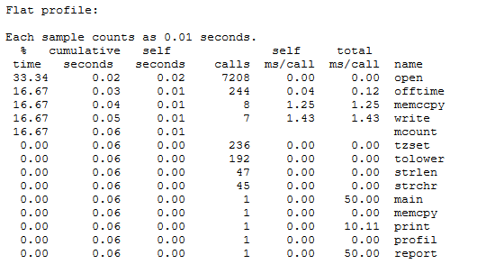

Automatic instrumentation
(Avoid it 99,999% of the time)
Deceptive overhead❌
« Useful » to know the number of function calls
Gprof, tyoma/micro-profiler, …
Read this StackOverflow

Slide 25
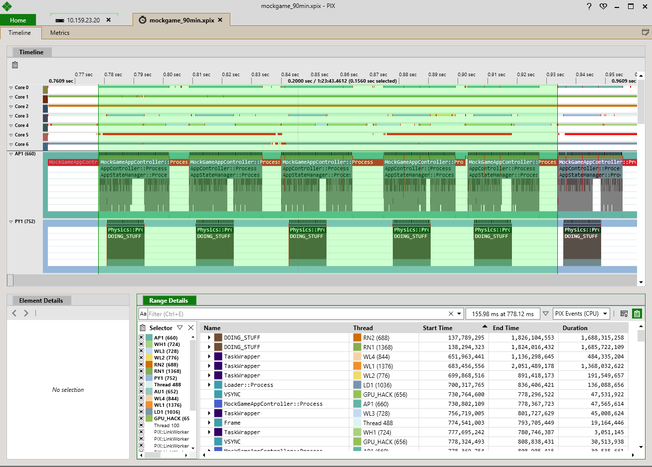
Manual instrumentation
Precise! ✅
Macro view! ✅
Business logic hierarchy ✅
No details ❌
Requires code changes❌
Remotery, easy_profiler, …

Slide 26
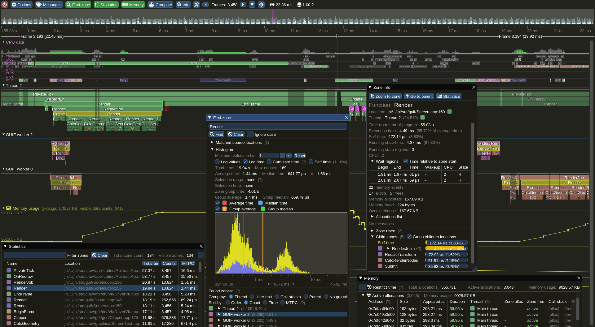
Instrumentation + Sampling
Best of both worlds
Microsoft PIX for Windows
Tracy
Optick
Superluminal
Perfetto
…

Slide 27
Profiler wishlist
Lightweight
Accurate
Multi-threading support
Thread naming
Context switch details
I/O measurements
Memory measurements
Custom data sources
Cross-platform
A good UI/UX
Can save sessions
Fibers/coroutines support?
Can be attached to a running app
CI support?
…
Notes:
Bad UX: GPU view

Slide 28

Macro-optimization
Looking at the big picture

Slide 29
Compilation flags
Quick to check and test
GCC/Clang
-O3
-march=native
MSVC
/O2
/arch:???
-flto
/GL, /LTCG
-ffast-math⚠
/fp:fast ⚠

Slide 30
Do nothing
The best of optimizations
Avoid unneeded processing
Avoid unneeded initialization/copies
Avoid unneeded (re)allocations (use reserve()!)
Avoid using mutexes (and reduce the code it guards)
Avoid duplicated function calls (abstractions!)

Slide 31

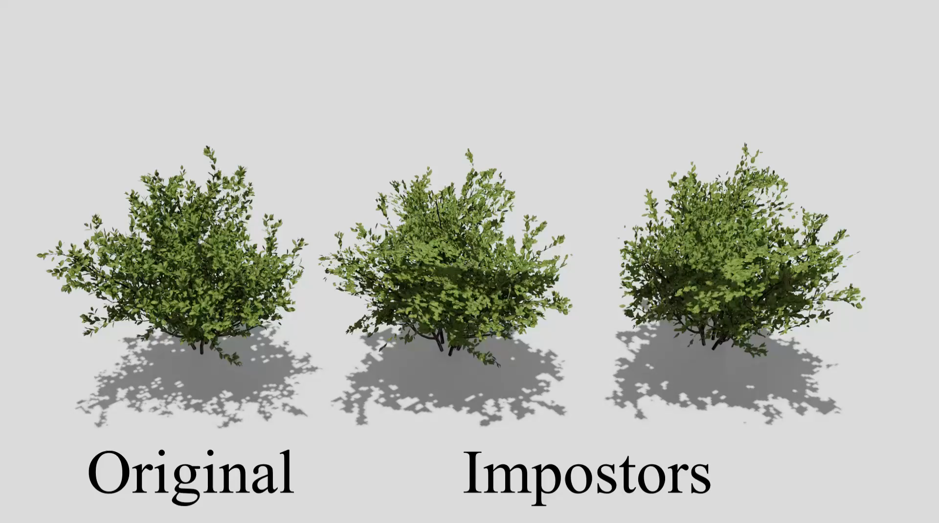
Adapt your data or design

Slide 32

Adapt your data or design
Yann Richard ©

Slide 33
In order of efficiency:
Do less
Do it faster
Prepare data (compress, pre-compute, …)
Multi-core (parallelism, latency hiding, …)
Caching (do this last or you’ll regret it!)

Slide 34
Latency Vs Throughput
How many times I can answer a request per second
How long does it take to answer a request

Slide 35

Micro-optimization
Close to the metal

Slide 36
CPU Cache
Temporal/Spatial locality of memory accesses
Store/access data linearly if possible (no linked lists!)
Pack your structures
Avoid indirections (unique_ptr<shared_ptr<unique_ptr>>>…)

Slide 37
Branch prediction
Avoid branches if possible
Slow path expected in branches (Intel/AMD)
Disable inlining on « big » functions may help
__builtin_expected/[[(un)likely]]
std::uint16_t clamp(int i) {
if (i < 0) [[unlikely]] {
return 0;
} else if (i > 0xFFFF) [[unlikely]] {
return 0xFFFFu;
}
return i;
}
10% faster! (on GCC 6…)
https://quick-bench.com/q/HLVEUIJsvsU6N6ms1SqOSeVodVI
Notes:
Toujours vérifier / mesurer !
Attention avec [[(un)likely]] !!! http://blog.aaronballman.com/2020/08/dont-use-the-likely-or-unlikely-attributes/
https://easyperf.net/blog/2018/07/09/Improving-performance-by-better-code-locality
https://dev.to/jacqueslucke/a-c-micro-optimization-exercise-3p65

Slide 38
SIMD (vectorization)
Single Instruction, Multiple Data!
SSE4.2: 98% of Steam’s market
AVX: 95% of Steam’s market
AVX2: 100% AWS, 90% Azure
Try to make it easy to auto-vectorize (break data dependencies in loops, align data)
Intrinsics
Implicit SPMD Program Compiler (ISPC)
VS
Notes:
https://store.steampowered.com/hwsurvey/
https://ispc.github.io/

Slide 39
The O(1), O(n), O(n²) myth…
The hidden truth
O(n) vs O(log(n)) vs O(1)
T(1)=?
Find
vector<uint32_t>
set<uint32_t>
unordered_set<uint32_t>
Insertion/modification cost?
Quick-bench
Notes:
Varies depending on the implementation (libstdc++, libc++, Microsoft STL)
Example to show that small numbers matter!
Graph with VS19 et cpu intel i7-970h
Clang 11.0 libstdc++ https://quick-bench.com/q/Vc1nXVhIWkp59LxzJuRlDioMcSA
Clang 11.0 libc++ https://quick-bench.com/q/70Aq9TIUTymeu46ydDduKW5r9xk
Gcc 9.3 https://quick-bench.com/q/wknFiLHUsgAM1OlNk1Q-_KeTCUA

Slide 40
A bit (well, a lot) of reading
Performance analysis and tuning of modern CPUs (Denis Bakhvalov)
Agner’s Optimization manuals
Intel® 64 and IA-32 Architectures Optimization Reference Manual
Software Optimization Guide for AMD Family 17h Models 30h and Greater Processors

Slide 41
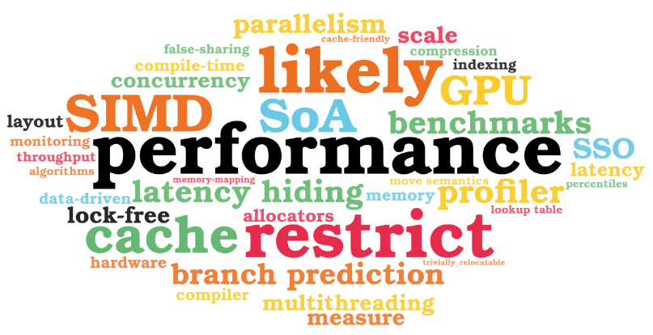
And much more…
Notes:
https://wordart.com/create performance
restrict
likely
branch prediction
latency hiding
SIMD
cache
benchmarks
profiler
SoA
multithreading
parallelism
concurrency
GPU
lock-free
compile-time
allocators
false-sharing
compression
compiler
measure
data-driven
latency
throughput
SSO
scale
indexing
hardware
monitoring
memory
move semantics
lookup table
algorithms
cache-friendly
layout
percentiles
memory-mapping
trivially_relocatable

Slide 42
War story: WebKit GC in a game
WebKit and real-time

Slide 43
Some context
WebKit used to display dynamic UIs, game components…
Target for a game is 60|30fps => 33|16ms
No JIT on console
« Old » WebKit version from ~2016
Frequent freezes could be observed

Slide 44
Remember:
Measure 1st (we already have our target: 60/30fps)

Slide 45
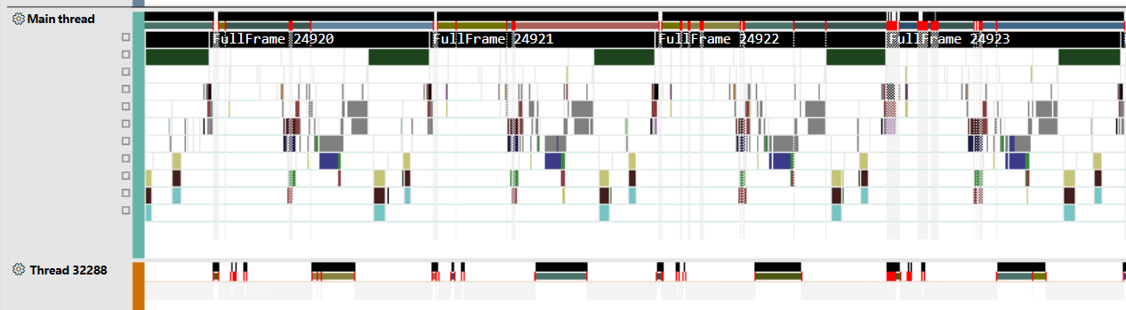
Start collecting data
Conquered land
Red flag
No instrumentation, only sampling & context switches
Notes:
Time x axis
Squares of color: logical blocks, similar to callstack but with instrumented names

Slide 46
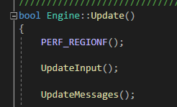
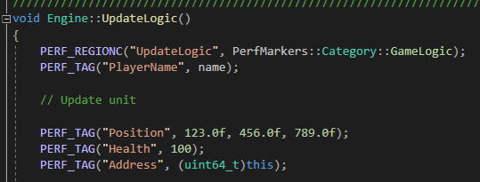
What it looks like in the code
Notes:
Easily added by looking at the sampled stacks and divide & conquer

Slide 47
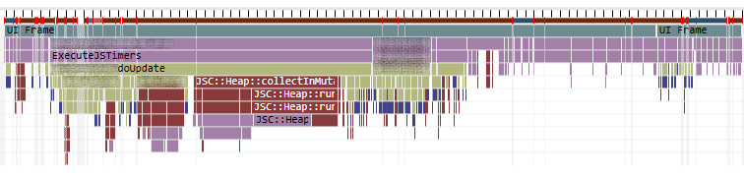
The garbage collector monster
Notes:
Brown squares (JSC::Heap) are GC passes
=> Correlated to the frame drops

Slide 48
What do we do now?
Many options
Tweak the garbage collector parameters
Optimize the garbage collector
Make it less blocking
Rewrite the code in C++
Reduce the amount of data to process
Ship it

Slide 49
Reduce the amount of data to process
Big wins without diving into WebKit
Analyze what generates memory usage
Fix JS code to generate less memory allocations
Sadly not enough
Still no control over when the GC will happen
Still have frequent « freezes » due to GC
Notes:
JS not friendly:
Everything allocates, even member functions (when arrow functions)
There are patterns to avoid
Avoid DOM access and modifications…

Slide 50
Eden vs Full GC
Sometimes GC takes 70ms, sometimes « only » 10ms?
Full GC
Iterates over all allocations!
Eden GC
Iterates only over objects allocated/changed since the previous GC
This is what we want most of the time in a game loop

Slide 51
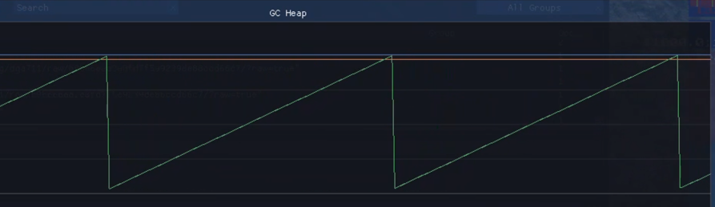
Avoiding full GC
Full GC always triggered after eden
Solution: Trigger only if size after GC is
above full GC threshold
X% greater than previous post-full GC size
Eden GC size threshold
Current memory size

Slide 52
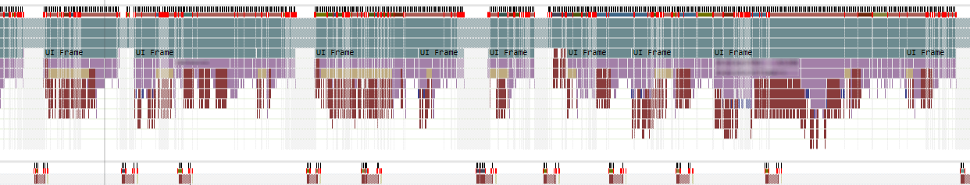
GC may pause execution to run
Scheduler not a good fit for realtime purposes

Slide 53
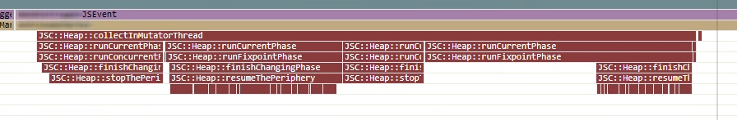
Prologue & epilogue of GC passes are expensive
stop/resumeThePeriphery
Actual useful work

Slide 54
A normal frame
VSYNC
VSYNC
Game logic
Rendering, Physics, Animation, …
Game logic
Sync point
UI logic
UI logic

Slide 55
Here be dragons (GC)
VSYNC
VSYNC
Game logic
Wait
Rendering, Physics, Animation, …
Game logic
Sync point
UI logic
UI logic
Missed
deadline!
GC

Slide 56
The solution
VSYNC
VSYNC
Game logic
Rendering, Physics, Animation, …
Game logic
Sync point
UI logic
GC
UI logic
Budget = end of frame + time to sync

Slide 57
Bonus point

Slide 58
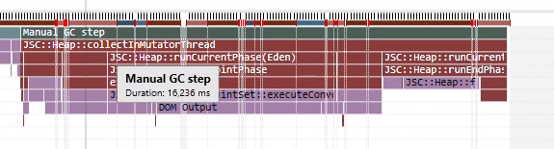
Update JSCore to benefit from multi-threading
Take advantage of all the cores!
GC step without MT

Slide 59
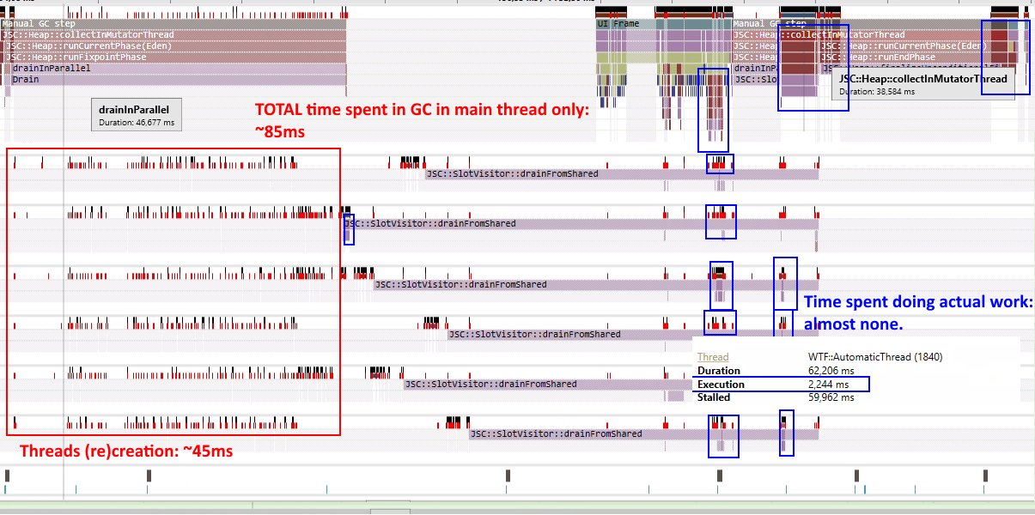
Update JSCore to benefit from MT?
Notes:
Note numbers do not match with the 16ms before, that’s because threads are mostly sleeping and being interrupted

Slide 60
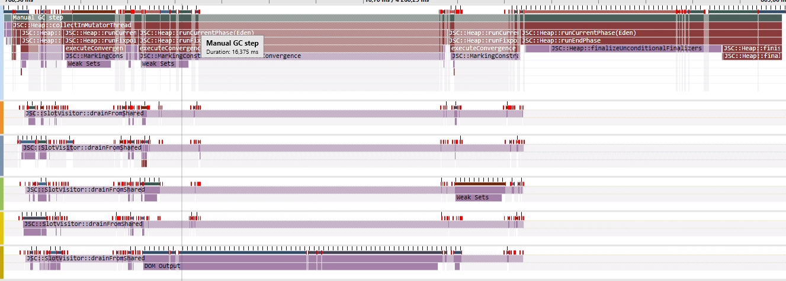

Update JavaScriptCore to benefit from MT
Does not scale as-is

Slide 61
Update JSCore to benefit from multi-threading
The wild goose chase
GC step without MT

Slide 62
Many more optimizations
Not really C++
Reduce string copies for C++ ⬄ .js communications
Reduced allocations and indirections in WebKit
No getters/setters => slow path in VM
Reduce DOM interactions
Functions forcing layout (Element.getBoundingClientRect())

Slide 63
If you had to remember one thing
Measure, measure, measure!
(and understand what you measure)

Slide 64
Thank you! (contact me)
Email: clement@siliceum.com
Twitter: @lectem Discord: #include

Slide 65
Appendix

Slide 66
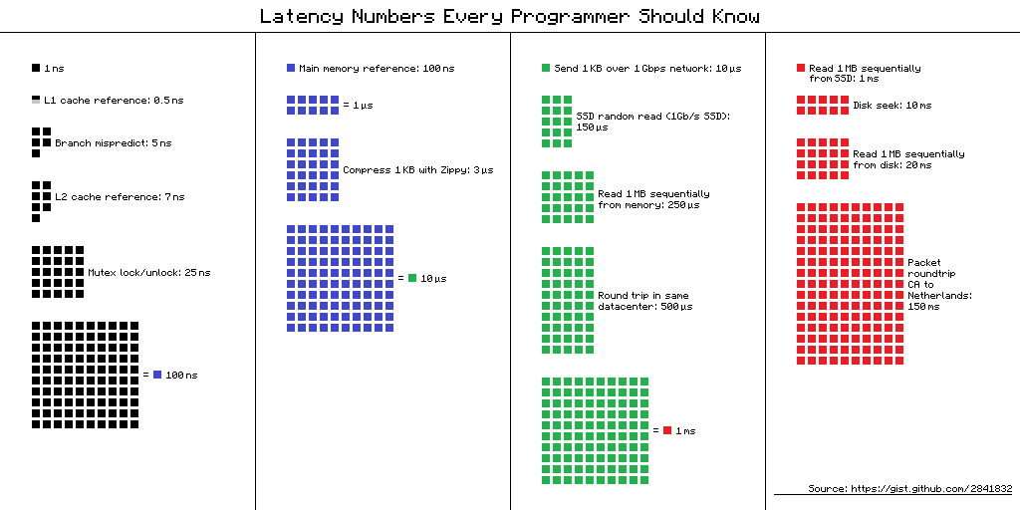

Slide 67
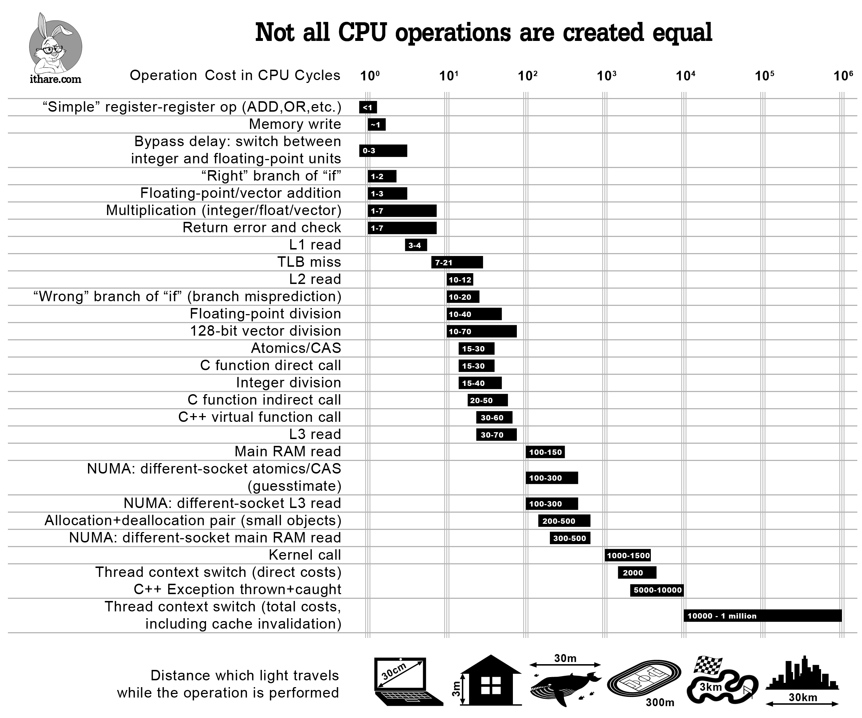
Notes:
http://ithare.com/infographics-operation-costs-in-cpu-clock-cycles/

